Slide 1


CS 2704 Project
Kyle Allan

Slide 2
GitHub
https://github.com/Kyle-Allan/CS-2704-Project

Slide 3
Question
Is a country’s happiness index based on the rate of the country’s population having some formal education?

Slide 4
Background
This analysis aims to understand the link between a country’s formal education rate and its happiness index.
The happiness index is used to measure satisfaction with life and it is based on several factors such as community, health, the feeling of happiness, and other factors.
Formal education is an organized and structured system of education.

Slide 5
Hypothesis
The happiness index of a country has a correlation with the rate of its population having some formal education.

Slide 6
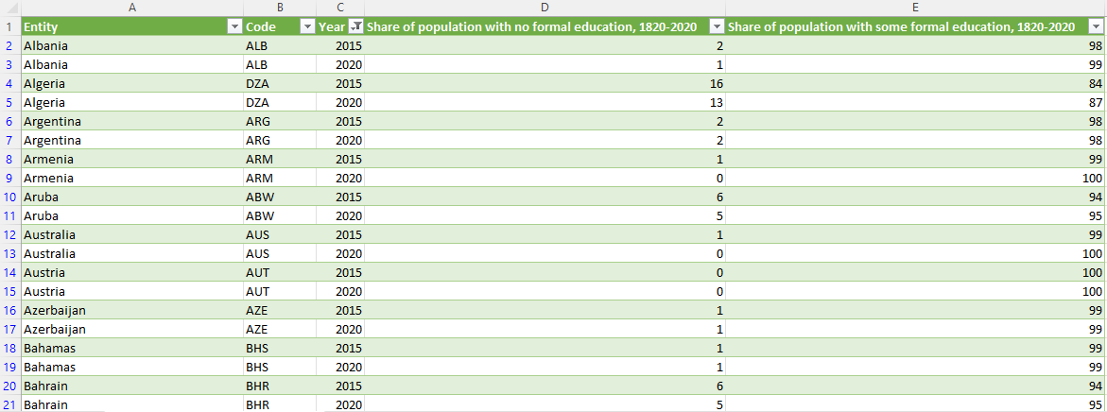

Formal education dataset

Slide 7
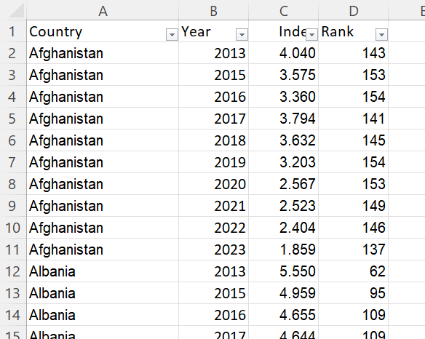
Happiness index dataset

Slide 8
Guess
I guess that there will be a correlation between a county’s happiness index and its rate of formal education.
The higher rate of formal education will correlate with a higher happiness index and the opposite will be observed in the output.

